Slide 1
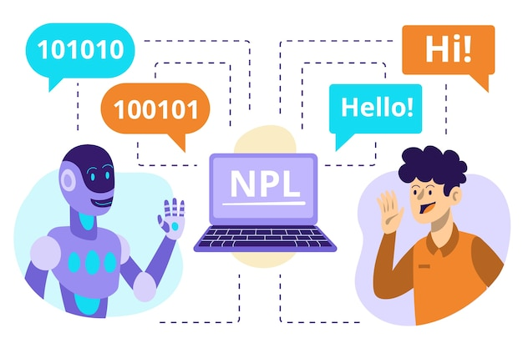
Introduction to NLP
Week 1
CSY3055 – Natural Language Processing
Dr Oluseyi Oyedeji

Slide 2
Learning Goals for Week 1
By the end of week one, you should be able to:
Understand the scope of NLP
Recognise challenges in processing human language
Describe the NLP pipeline and levels of analysis
Summarise the history and evolution of NLP
Get hands-on experience with some basic NLP tools
Reflect on ethics in NLP (introductory)

Slide 3
Today’s Session
What is NLP?
Relevance of NLP
NLP in AI hierarchy
History of NLP
Challenges with Human Languages
Level of NLP Analysis
NLP Pipeline
Applications of NLP
Recent Advancements
NLP Tools
Ethics in NLP

Slide 4
What is NLP?
NLP is a Subfield of AI & computational linguistics
Enables machines to process, understand, generate human language
Input = unstructured text/speech → Output = structured meaning/action

Slide 5
Relevance of NLP
Assistants & Translation
Digital assistants: Siri, Alexa, Google Assistant
Machine translation: Google Translate, DeepL
Search & Chatbots
Information retrieval: Google Search
Chatbots & customer support
Sentiment & Summarisation
Sentiment analysis: reviews, tweets
Automatic summarisation, news aggregation

Slide 6
Relevance of NLP contd.
Q&A and Misinformation
Question answering: ChatGPT, WolframAlpha
Misinformation detection and prevention

Slide 7
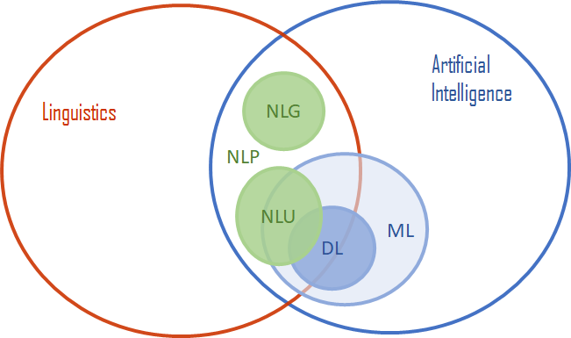
NLP in the AI Hierarchy
AI = broad goal of intelligent machines
ML = learning from data
DL = neural networks
NLP = intersection of AI, ML, and linguistics

Slide 8
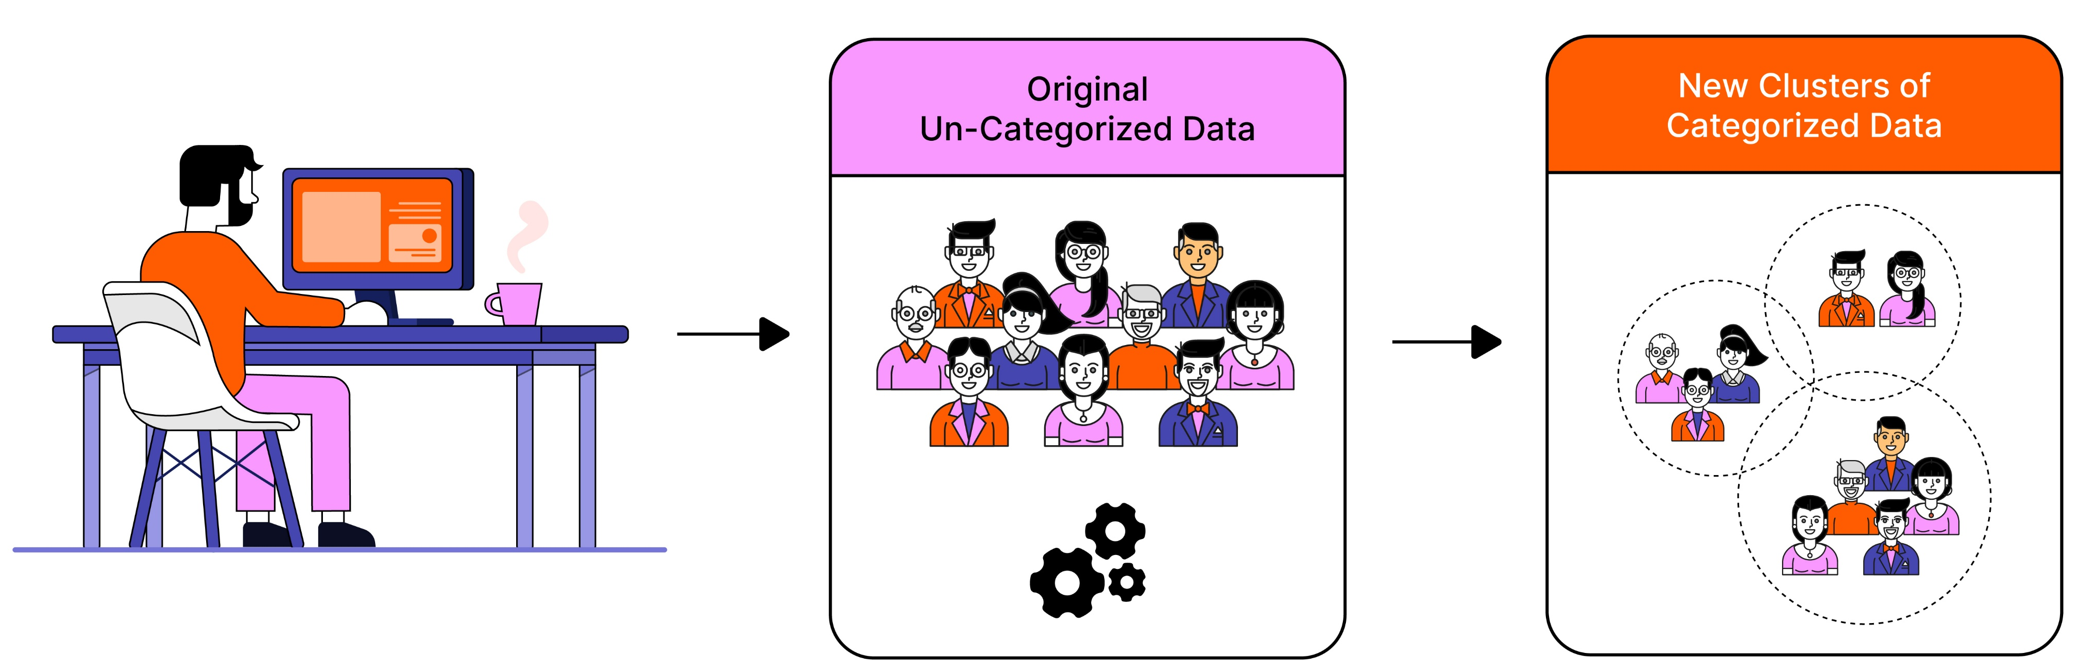
History of NLP
1950s–60s
Rule-based MT (Georgetown experiment, 1954)
ELIZA chatbot (1966)
1970s
AI-inspired Q&A (BASEBALL system)
Shift towards linguistics + AI approaches
1980s
Grammar-based systems
Formal parsing techniques, discourse analysis

Slide 9
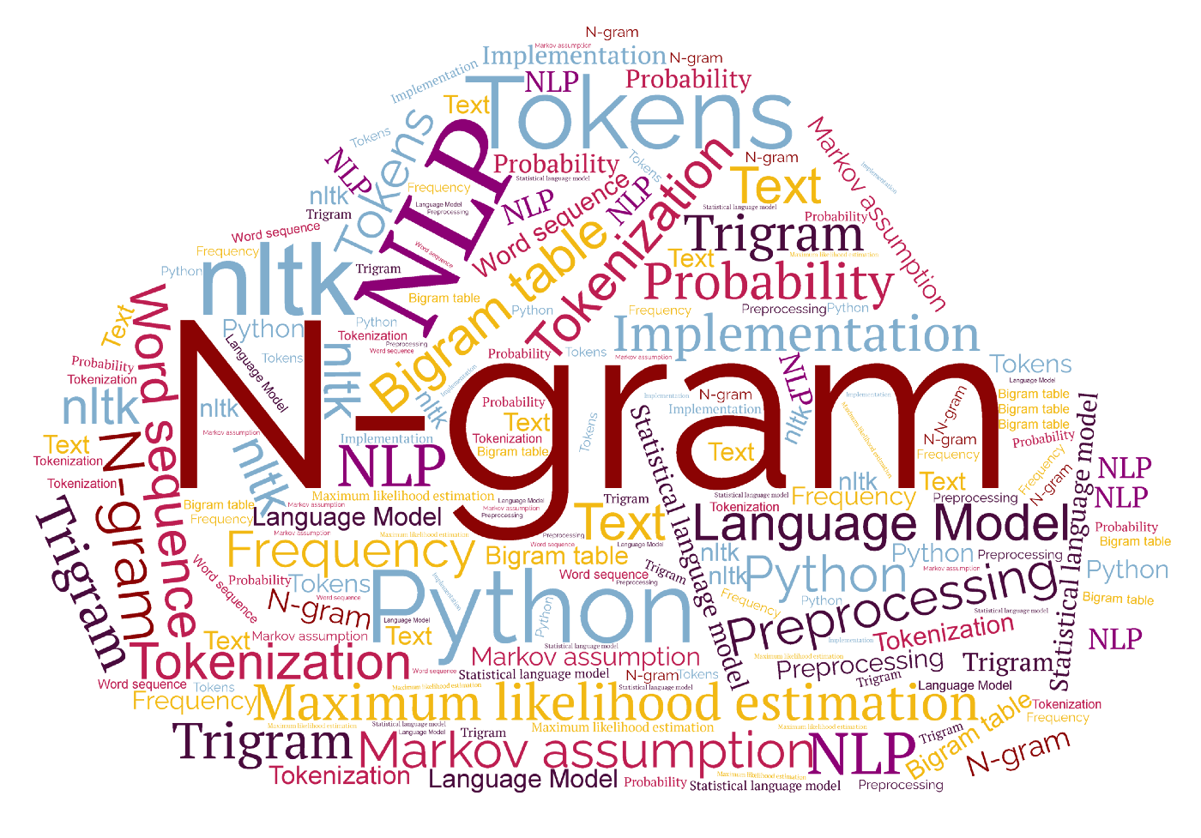
History of NLP
1990s
Statistical revolution
n-grams, HMMs, probabilistic models
2000s
Rise of ML algorithms: SVMs, CRFs, TF-IDF
Growth of large annotated corpora
2010s
Word embeddings: Word2Vec, GloVe
Deep learning: RNNs, LSTMs, GRUs

Slide 10
History of NLP
2017 +
Transformers: 'Attention is All You Need'
BERT, GPT, T5
Current era: Large Language Models (GPT-4, GPT-5, Claude, LLaMA)

Slide 11
Challenges with Human Language
Lexical Ambiguity
One-word, multiple meanings
Example: 'bank' → riverbank or financial institution
Syntactic Ambiguity
Sentence: 'I saw the man with the telescope'
Ambiguity: who has the telescope?

Slide 12
Challenges with Human Language
Semantic Ambiguity
Contradictory meanings: 'Hot ice-cream'
Difficult for machines to resolve
Pragmatic Ambiguity
Language depends on context
'Can you pass the salt?' = request, not question

Slide 13
Other Language Challenges
Context dependence
Need for world knowledge
Low-resource languages = lack of data/tools

Slide 14
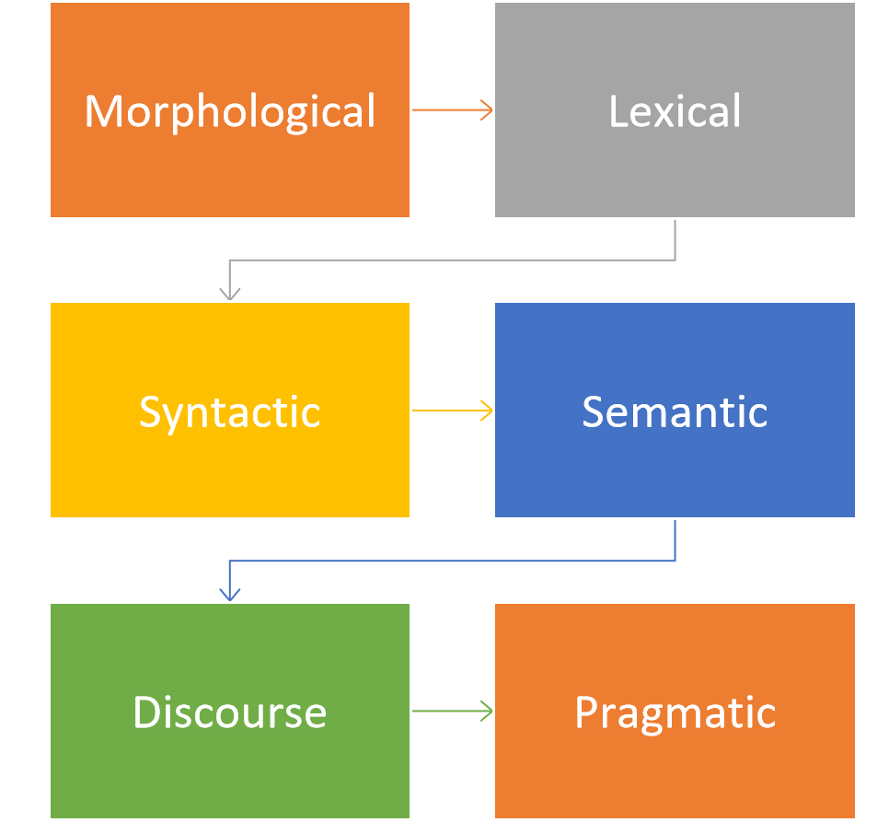
Levels of NLP Analysis

Slide 15
Levels of NLP Analysis – Morphology
Morphology is the study of word structure
Tokens, morphemes, stemming, lemmatization
Tokenisation
Splitting text into words/tokens
Example: 'NLP is amazing!' → ['NLP','is','amazing',’!’]
Stemming and Lemmatization
Stemming: relational → relate (rule-based cut)
Lemmatization: running → run (dictionary-based)

Slide 16
Levels of NLP Analysis - Syntax
Syntax is the grammatical structure of sentences
Parsing methods
Constituency –> sub-phrases
Dependency - direct relationship
Sentence: 'The cat sat on the mat’
Constituency parse: [S [NP The cat] [VP sat [PP on [NP the mat]]]]
Dependency parse: subject=cat, verb=sat, object=mat

Slide 17
Levels of NLP Analysis – Semantic, Discourse, Pragmatics
Semantics is the study of meaning
Word sense disambiguation, synonymy, polysemy
Discourse refers to meaning across sentences
Coreference resolution, coherence
Pragmatics refers to language in context
Speaker intention, world knowledge

Slide 18
NLP Pipeline
Input text → Preprocessing → Feature extraction → Modelling → Evaluation → Deployment
Roadmap: raw language → structured meaning → useful applications
Helps connect theory to real-world systems

Slide 19
NLP Pipeline - Preprocessing
Tokenisation
Split text into words/sentences
Stop word removal
Remove frequent low-value words
Stemming & Lemmatization
Reduce words to root forms
Normalisation
lowercase, punctuation handling, cleaning

Slide 20
NLP Pipeline - Feature Extraction
Bag-of-Words (BoW)
Count words
TF-IDF
Adjust counts for importance
Word embeddings: dense vectors (Word2Vec, GloVe)
Contextual embeddings: BERT, GPT

Slide 21
NLP Pipeline - Deployment
Integrating NLP into apps and services
Chatbots, search engines, recommendation systems
Challenges
Scalability, fairness, bias, ethics
Tools
Flask, FastAPI, cloud APIs

Slide 22
Applications of NLP
Machine translation
Speech recognition & synthesis
Sentiment analysis
Information retrieval & search
Summarisation
Question answering
Chatbots & virtual assistants
Text generation (LLMs)

Slide 23
Recent Advancements
Word embeddings (Word2Vec, GloVe)
Distributed representations
Semantic similarity capture
Neural LMs: RNN, LSTM, GRU
Sequence modelling
Transformers: Attention, BERT, GPT - Self-attention mechanism
LLMs: GPT-4, Claude, LLaMA → Large scale, zero/few-shot learning

Slide 24
NLP Toolkits
Classical tools
NLTK (Natural language toolkit)
Stanford CoreNLP (Java-based parser)
Modern Tools
spaCy (efficient NLP pipelines)
Gensim (topic modelling, embeddings)
Hugging Face Transformers (pre-trained DL models)

Slide 25
NLP Toolkits contd.
Programming Language
Python
R and Java exist, but Python dominates
Deep Learning Frameworks (for building models)
PyTorch → dominant in research & LLMs.
TensorFlow / Keras → popular in industry & ML pipelines.
JAX → rising for high-performance training (used by Google).

Slide 26
Ethics in NLP
Bias in embeddings (gender/race stereotypes)
“doctor → male” and “nurse → female” associations.
fairness and discrimination.
Data privacy issues (memorising sensitive data)
Misinformation (deepfakes, fake news)
Environmental cost (training large LLMs)

Slide 27
Discussion
If a spam filter wrongly blocks scholarship emails for international students, what are the consequences? How could this be avoided?

Slide 28
Summary
NLP = AI + ML + linguistics
Human language is complex: ambiguity, context
History: rules → statistics → ML → DL → transformers
Applications: translation, chatbots, search
Tools: NLTK, spaCy, HuggingFace
Ethics: bias, privacy, environment

Slide 29
Thank you

